Slide 1
FABRICEDGE TEXTILES

Slide 2
INTRODUCTION:
A textile management system is a software solution designed to streamline and automate processes related to inventory management, production planning, sales, and customer relationship management in the textile industry. It helps businesses optimize operations, improve efficiency, and enhance customer satisfaction.

Slide 3
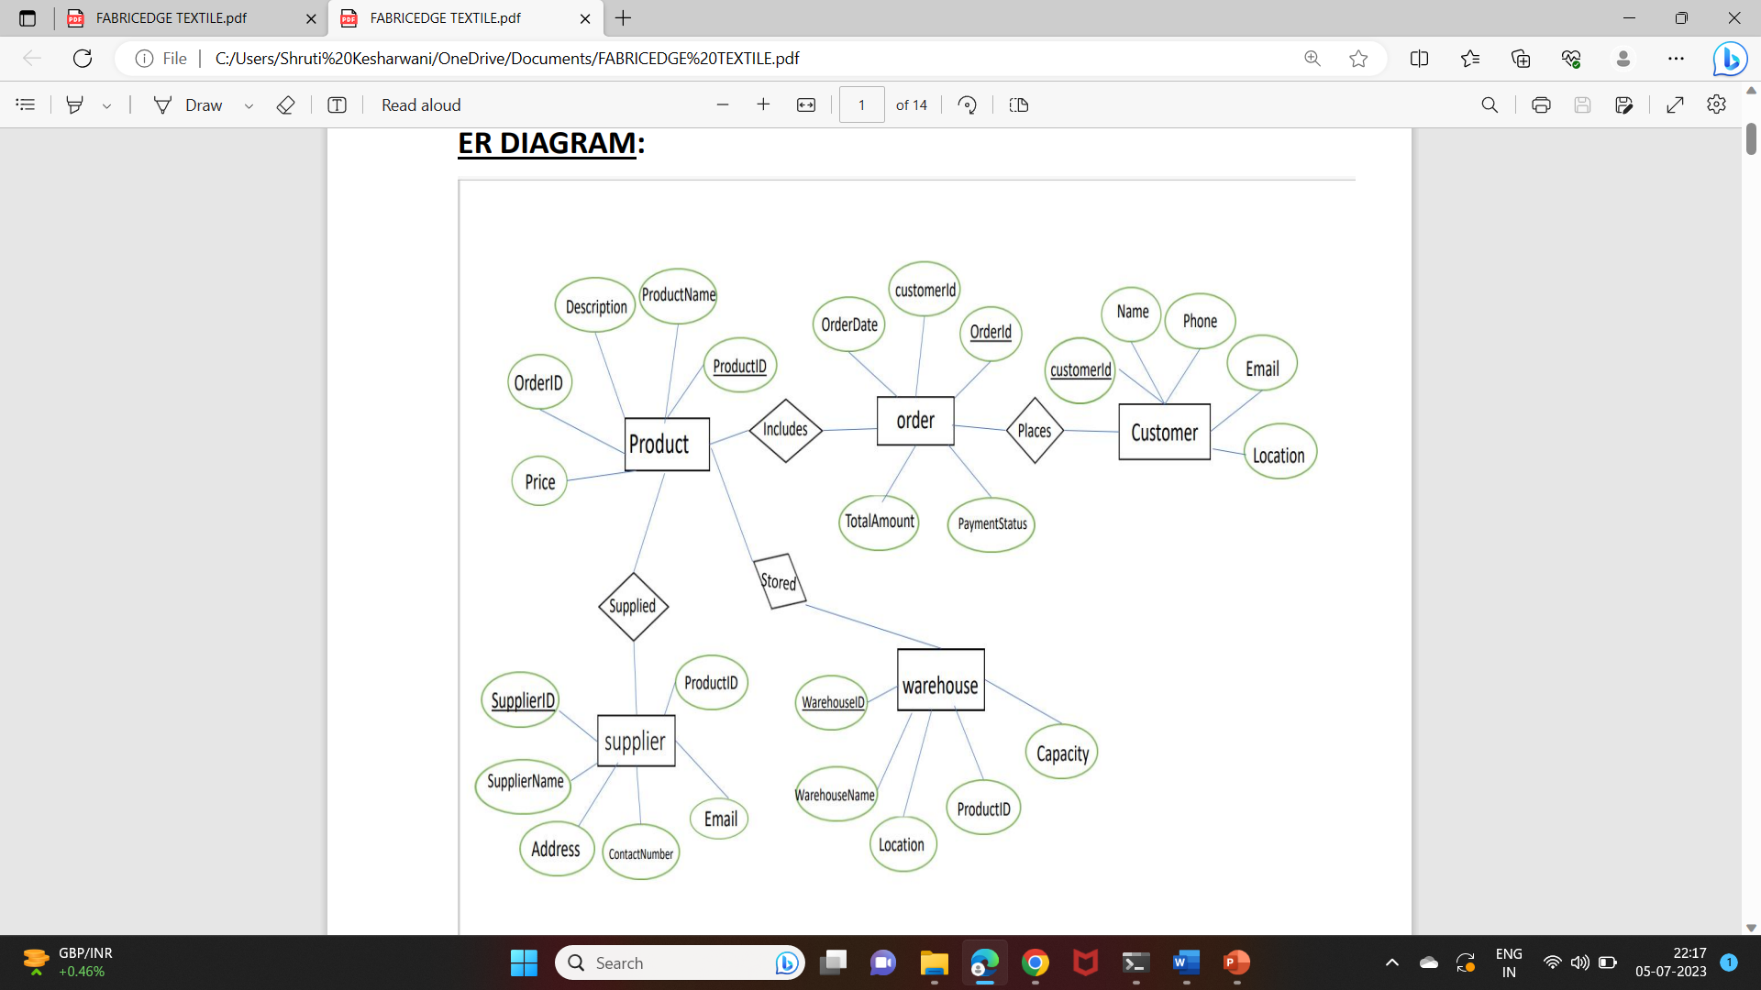
ER DIAGRAM:

Slide 4
STRUCTURE OF TABLES

Slide 5
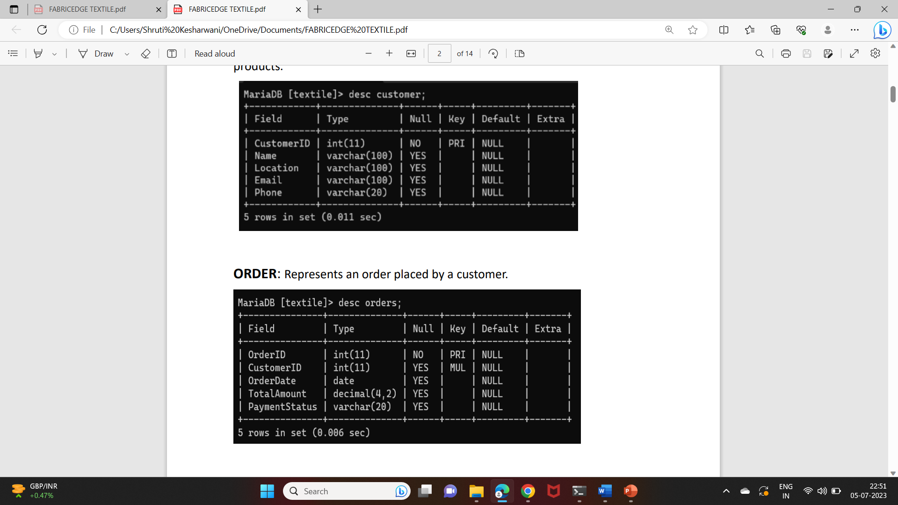
CUSTOMER:
Represents the individuals or organizations who purchase textile products.

Slide 6
ORDER:
Represents an order placed by a customer.

Slide 7
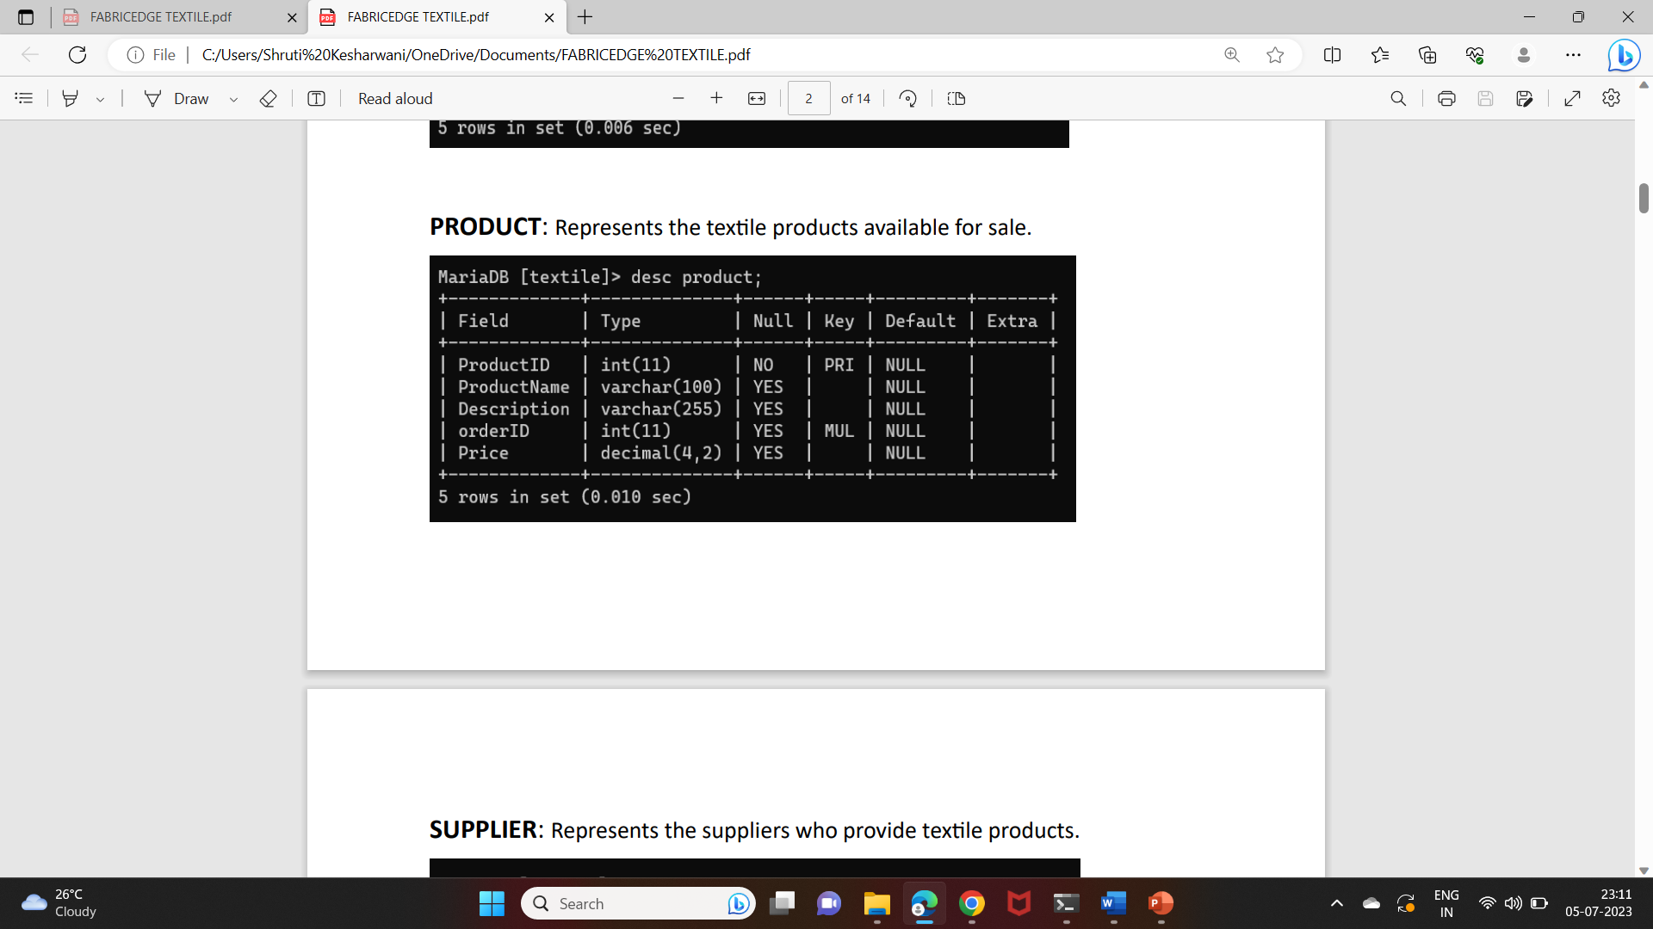
PRODUCT:
Represents the textile products available for sales.

Slide 8
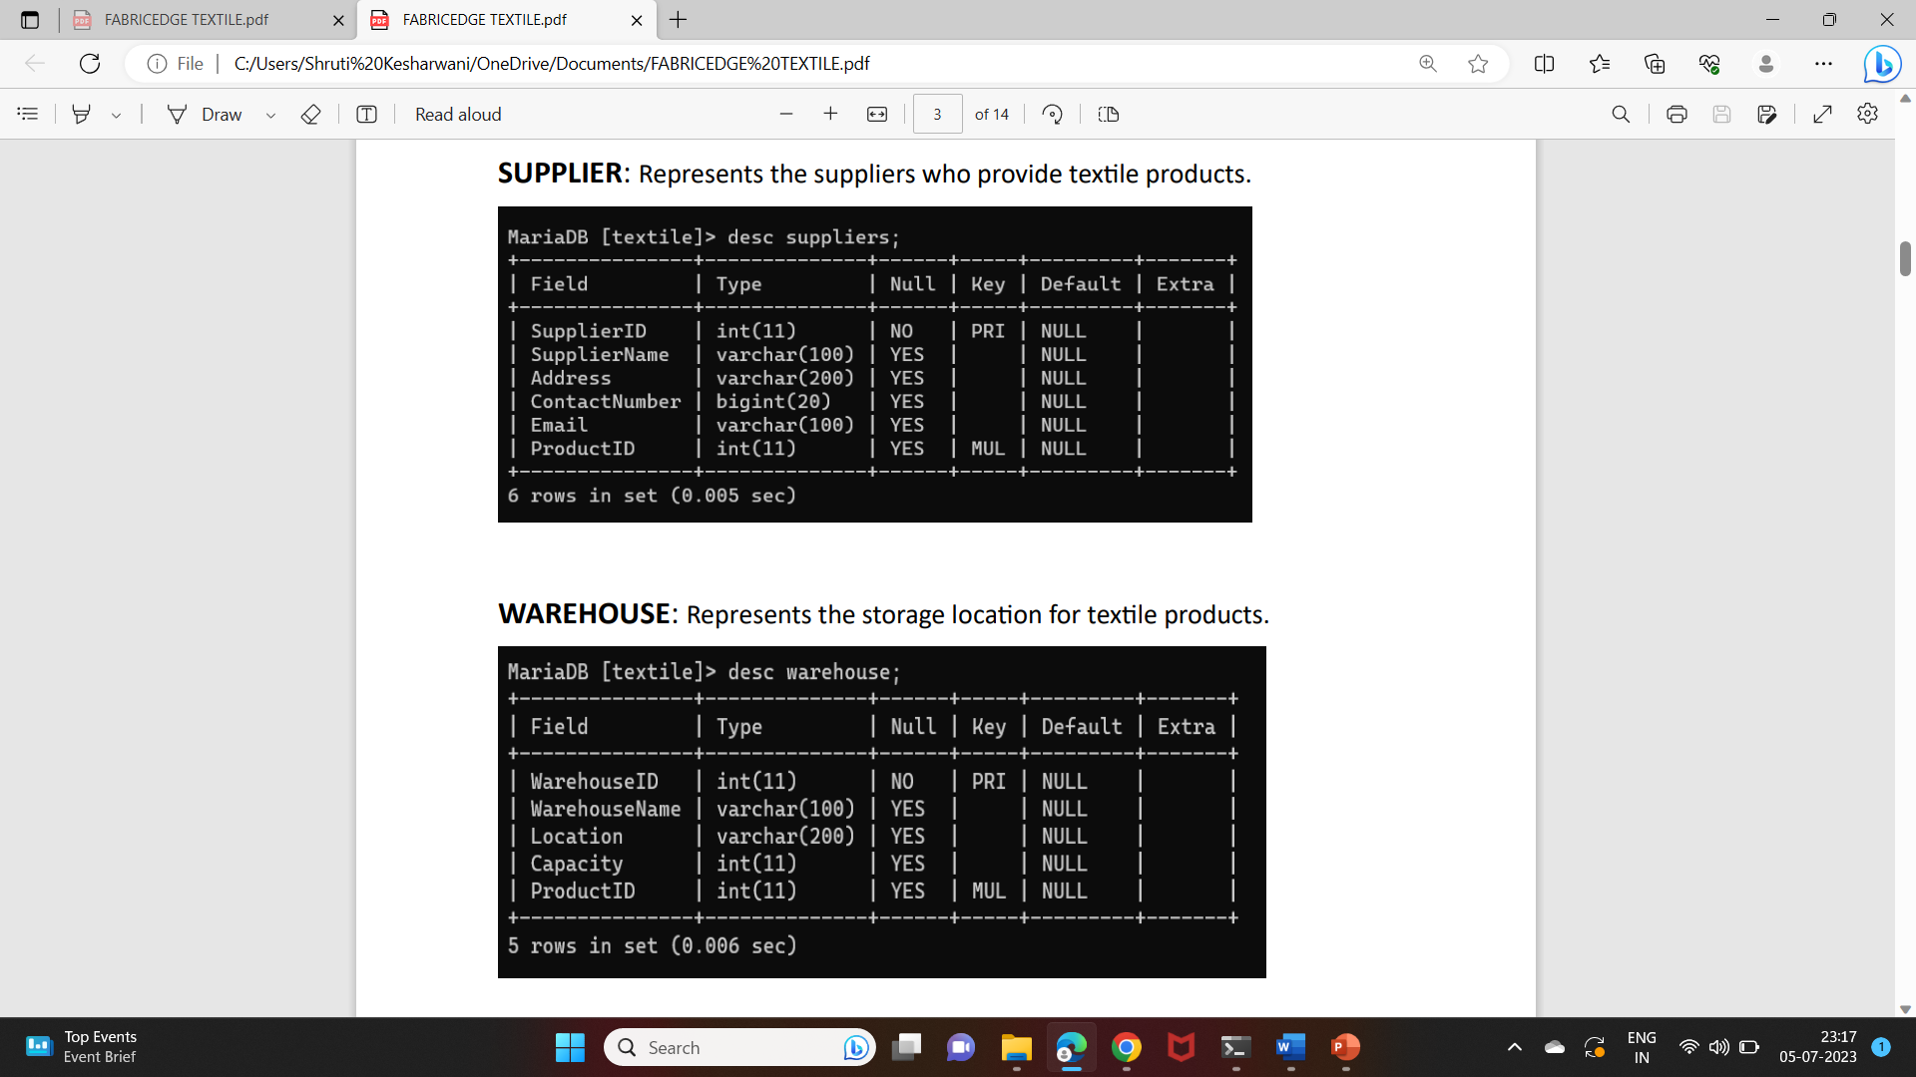
Supplier:
Represents the suppliers who provide textile products.

Slide 9
WAREHOUSE:
Represents the storage location for textile products.

Slide 10
Contents of tables

Slide 11
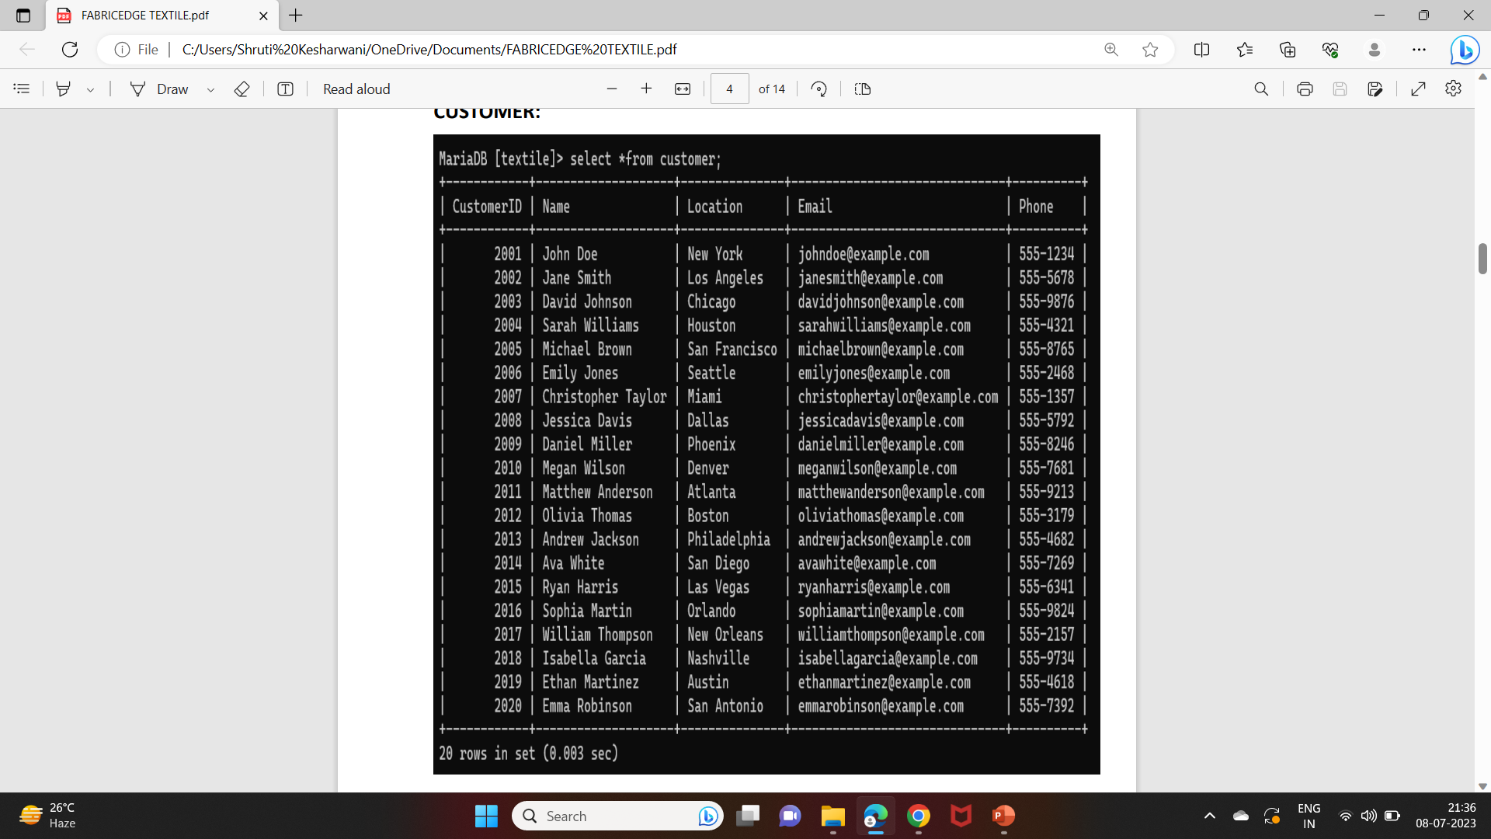
CUSTOMER:

Slide 12
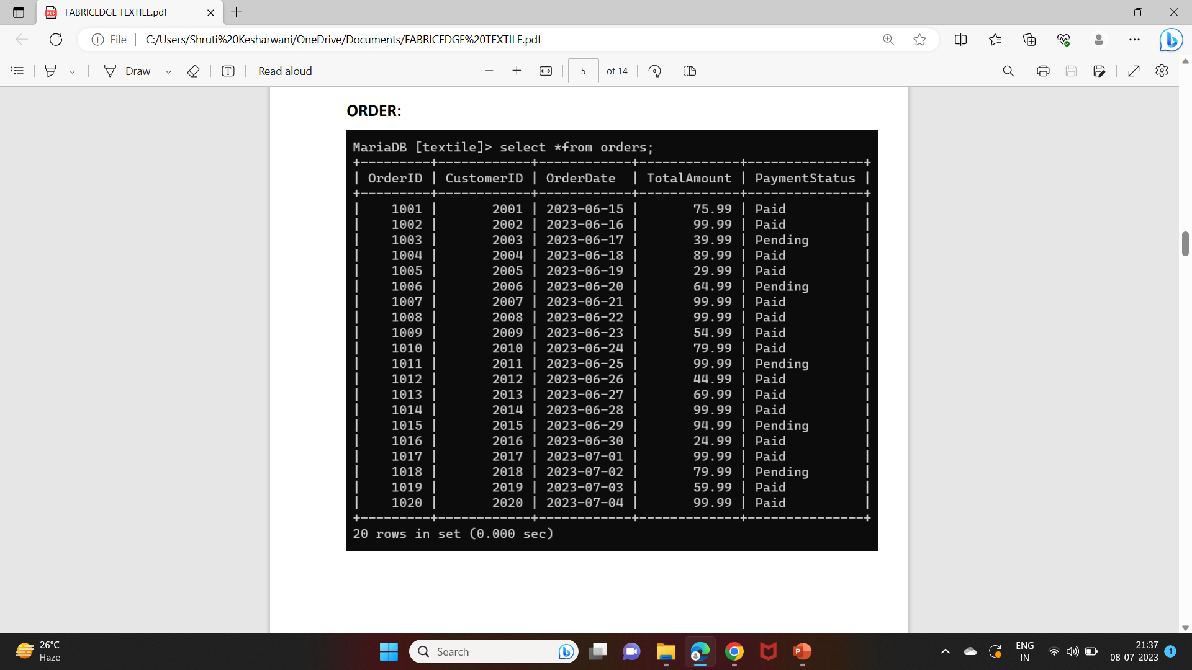
ORDER:

Slide 13
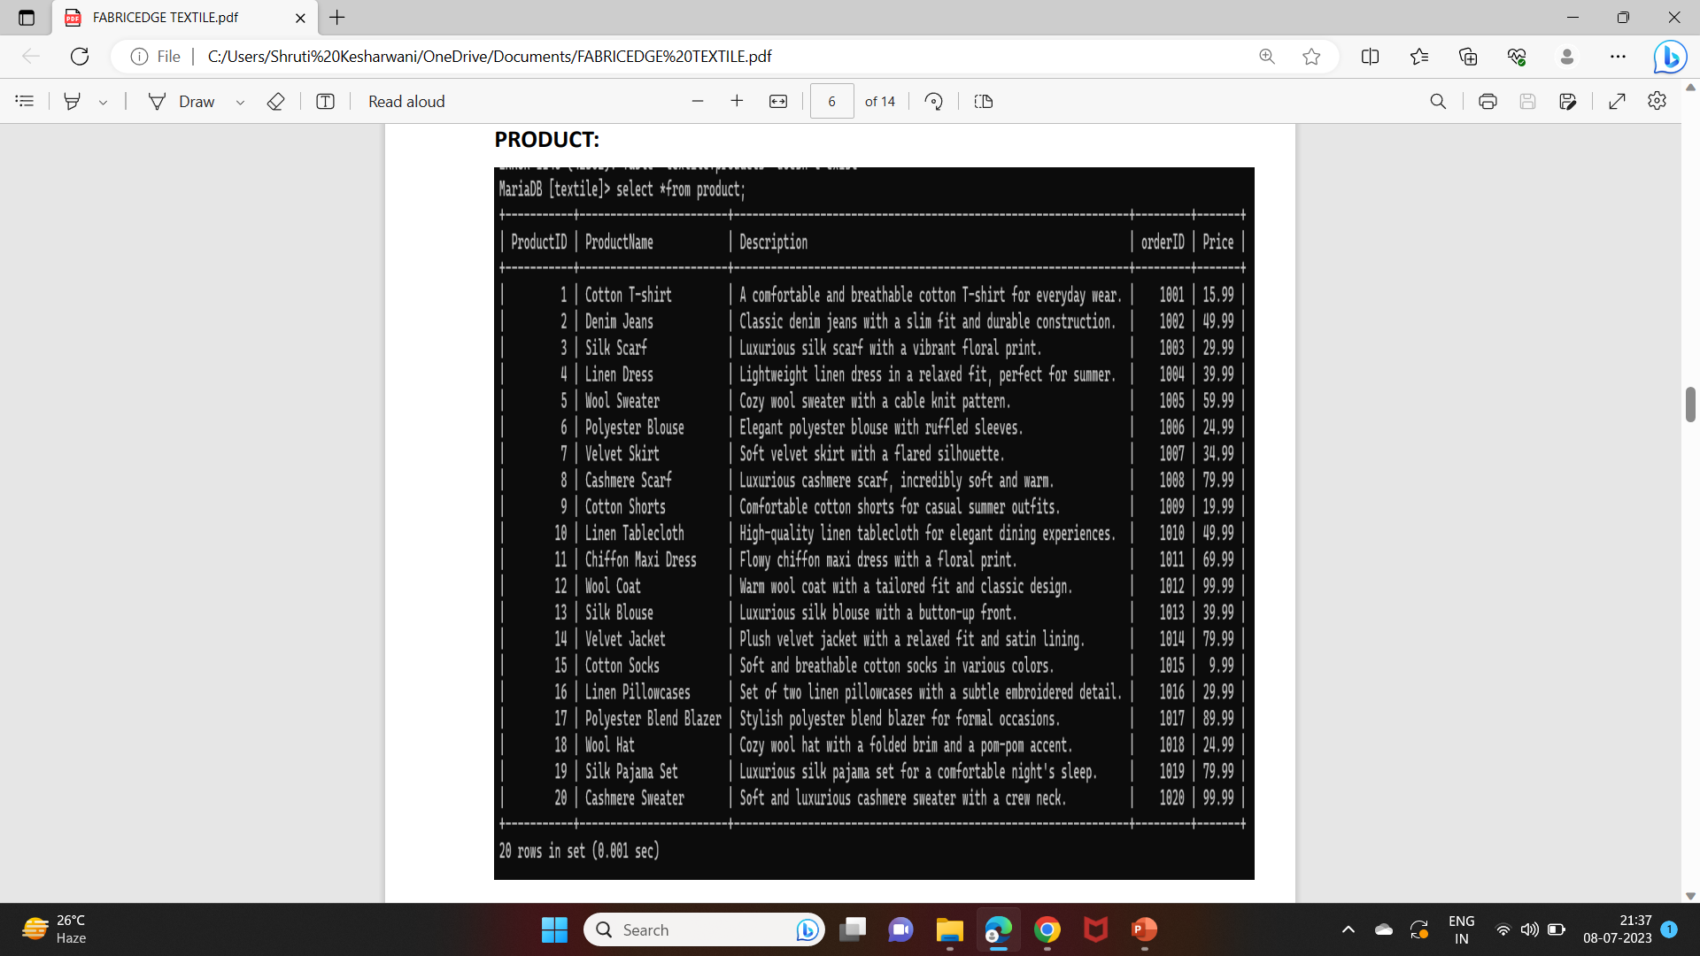
PRODUCT:

Slide 14
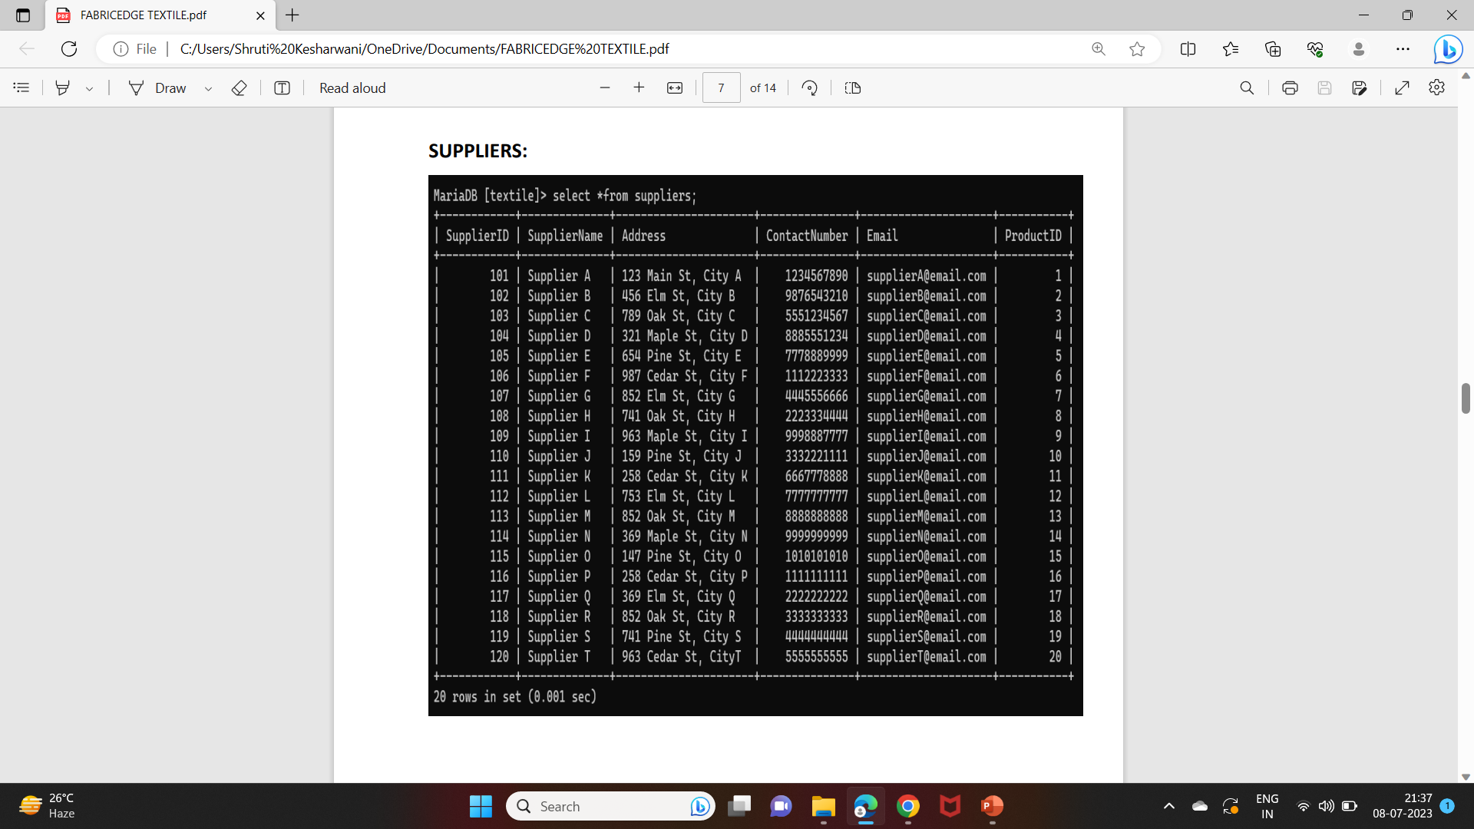
Supplier:

Slide 15
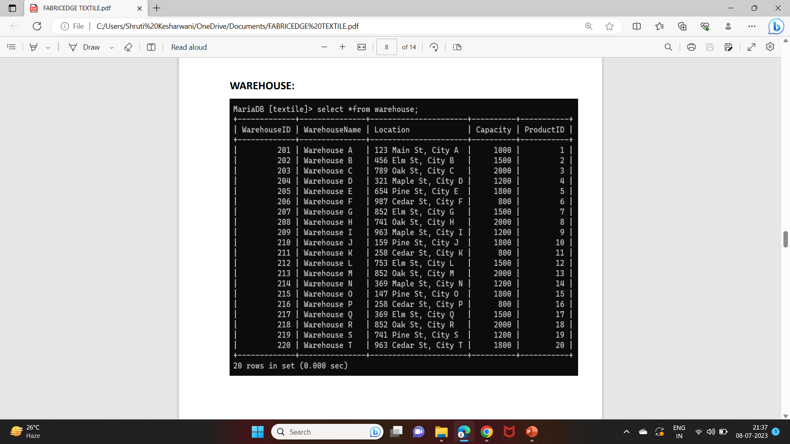
WAREHOUSE:

Slide 16
SUBQUERIES

Slide 17
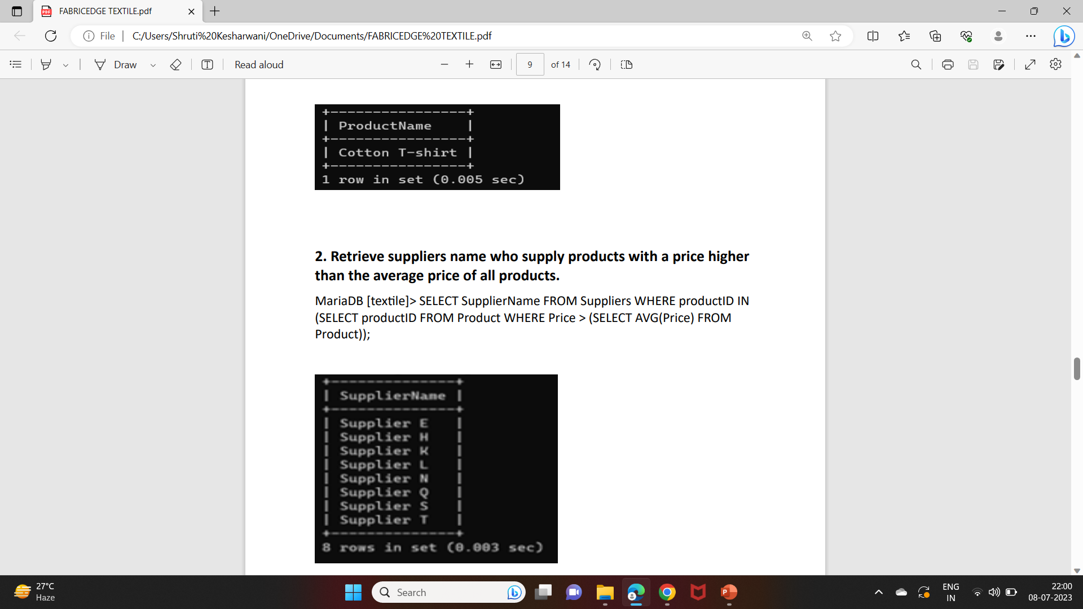
MariaDB [textile]> SELECT ProductName FROM Product WHERE ProductID IN (SELECT ProductID FROM Warehouse WHERE WarehouseName = 'warehouse A');
1. Retrieve the names of product stored in a specific warehouse.

Slide 18
2. Retrieve suppliers name who supply products with a price higher than the average price of all products.
MariaDB [textile]> SELECT SupplierName FROM Suppliers WHERE productID IN (SELECT productID FROM Product WHERE Price > (SELECT AVG(Price) FROM Product));

Slide 19
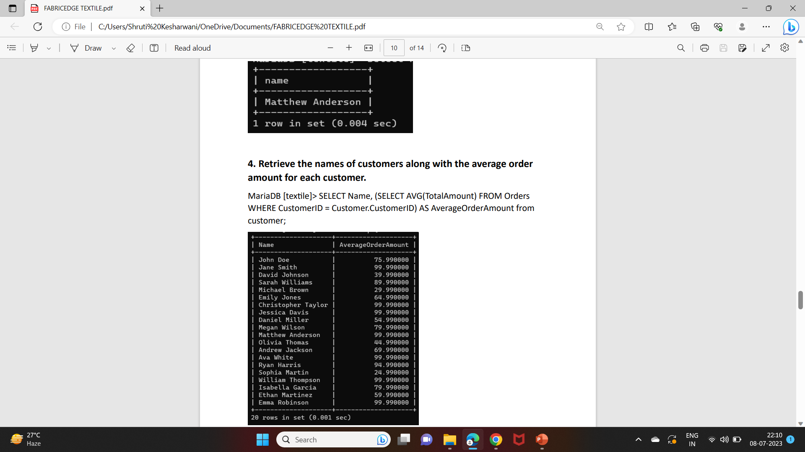
3. Retrieve the names of customer who have placed an order for a specific orderId =1011.
MariaDB [textile]> select name from customer where customerid in (select customerid from orders where orderid = '1011’);

Slide 20
4. Retrieve the names of customers along with the average order amount for each customer
MariaDB [textile]> SELECT Name, (SELECT AVG(TotalAmount) FROM Orders WHERE CustomerID = Customer.CustomerID) AS AverageOrderAmount from customer;

Slide 21
JOINS

Slide 22
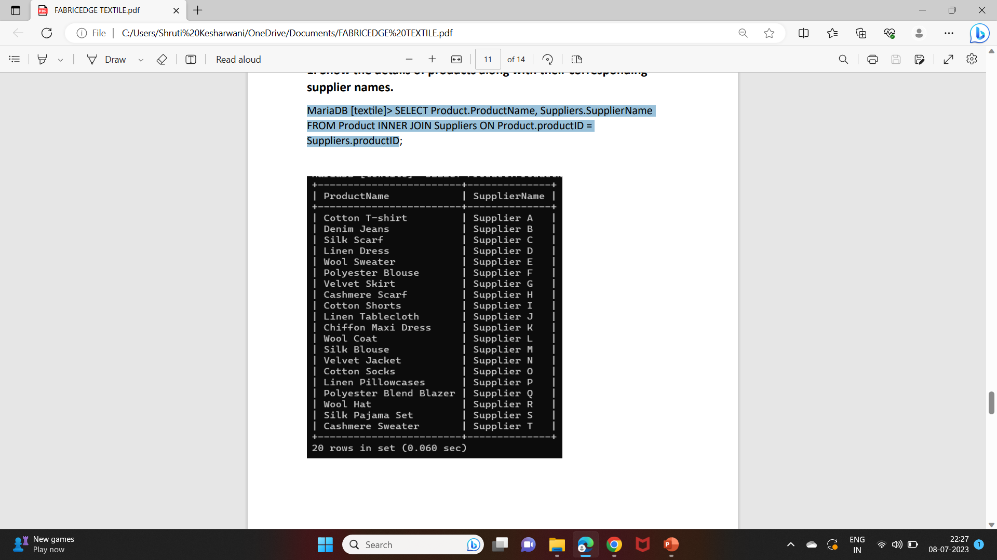
1. Show the details of products along with their corresponding supplier names.
MariaDB [textile]> SELECT Product.ProductName, Suppliers.SupplierName FROM Product INNER JOIN Suppliers ON Product.productID = Suppliers.productid;

Slide 23
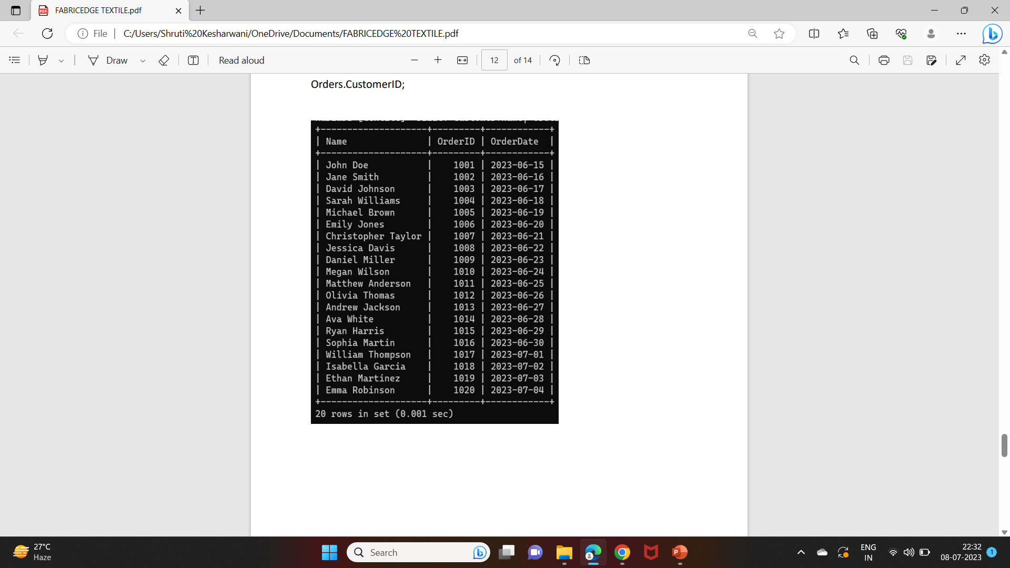
2. Retrieve all customers and their orders, including customers who have not placed any orders.
MariaDB [textile]> SELECT Customer.Name, Orders.OrderID, Orders.OrderDate FROM Customer LEFT JOIN Orders ON Customer.CustomerID = Orders.CustomerID;

Slide 24
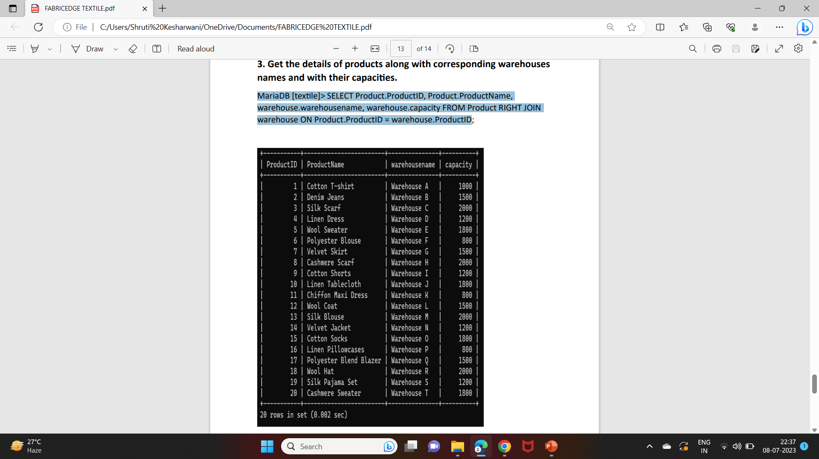
3. Get the details of products along with corresponding warehouses names and with their capacities.
MariaDB [textile]> SELECT Product.ProductID, Product.ProductName, warehouse.warehousename, warehouse.capacity FROM Product RIGHT JOIN warehouse ON Product.ProductID = warehouse.ProductID;

